Slide 1
Chapter 2: Intro to Relational Model

Slide 2
概念回顾
数据模型
是一个描述数据、数据联系、数据语义以及一致性约束的概念工具的集合。
数据模型的三要素
数据结构
数据及其它们之间的联系
数据操作
检索、更新等操作及其操作规则
完整性约束条件
规定数据库状态及状态变化所应满足的条件，以保证数据的正确、有效、相容

Slide 3
第二章 关系模型
教学目的
本章首先学习关系模型的基础，然后介绍关系代数，为稍后学习的关系数据库查询语言SQL打好基础
主要内容
关系基本概念，关系模型，关系代数，关系系统及其查询优化

Slide 4
RELATIONAL MODEL
2.1 Structure of Relational Databases
2.2 Database Schema
2.3 Keys
2.4 Schema Diagrams
2.5 Relational Query Languages
2.6 Relational Operations

Slide 5
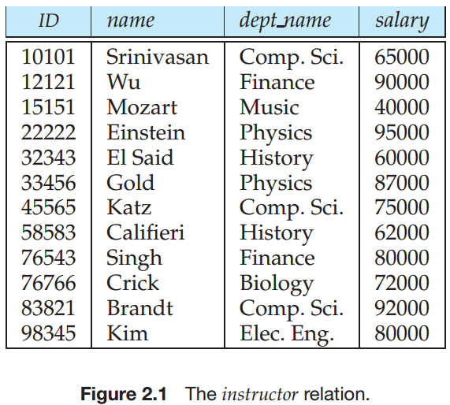
2.1 Structure of Relational Databases
Relational Database: a collection of tables
Table has a unique name
A row (tuple) in a table: a relationship of a set of values
Table: mathematical concept of relation
Relational Model: proposed by Codd, 1970, ref. p.1108: Bibliography
[Codd 1970] E. F. Codd, "A Relational Model for Large Shared Data banks," CACM Vol. 13, No.6, (1970), pp. 377-387

Slide 6
关系模型的组成
数据模型
数据结构、数据操作、完整性规则
关系模型的组成
数据结构（表）
关系操作集
关系完整性

Slide 7
2.1.1 Basic Structure
Relation:
Formally, given sets D₁, D₂, …. D_{n}
D₁ x D₂ x … x D_{n} = {(a₁, a₂, …, a_{n}) | where each a_{i} ∈ D_{i}}
a Relation r is a subset of D₁ x D₂ x … x D_{n}
Thus a relation is a set of n-tuples (a₁, a₂, …, a_{n}) where each a_{i} ∈ D_{i}
Example: if
customer-name = {Jones, Smith, Curry, Lindsay} customer-street = {Main, North, Park} customer-city = {Harrison, Rye, Pittsfield} Then r = {(Jones, Main, Harrison), (Smith, North, Rye), (Curry, North, Rye), (Lindsay, Park, Pittsfield)} is a relation over customer-name x customer-street x customer-city

Slide 8
Attribute Types
Each attribute of a relation has a name
The set of allowed values for each attribute is called the domain of the attribute
（A domain is atomic if elements of the domain are considered to be indivisible units. ）
Attribute values are (normally) required to be atomic, that is, indivisible
E.g. multivalued attribute values are not atomic
E.g. composite attribute values are not atomic, BirthDate: (5, 17, 1950)
The special value null is a member of every domain
The null value causes complications in the definition of many operations
we shall ignore the effect of null values in our main presentation and consider their effect later

Slide 9
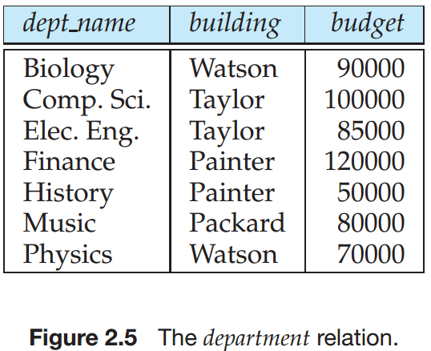
2.2 Database Schema
Attributes: Suppose A₁, A₂, …, A_{n} are attributes
Relation schema: R = (A₁, A₂, …, A_{n}) is a relation schema
e.g. department-schema = (dept name, building, budget)（Fig 2.5）
Relation: r(R) is a relation on the relation schema R
e.g. department(department-schema)

Slide 10
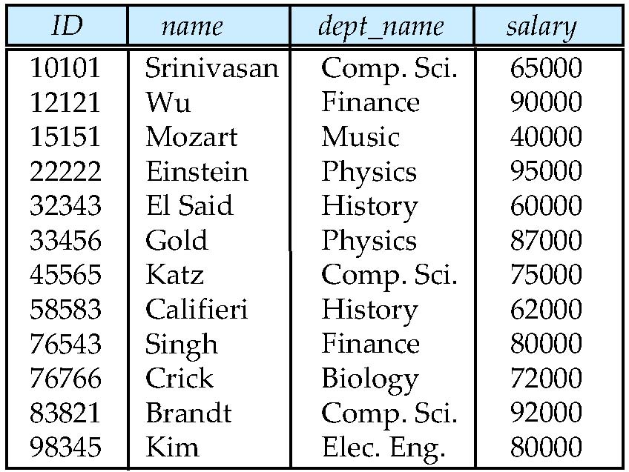
Relation Instance
Relation Instance: The current values (relation instance) of a relation are specified by a table
Tuple: An element t of r is a tuple, represented by a row in a table
attributes
(or columns)
tuples
(or rows)

Slide 11
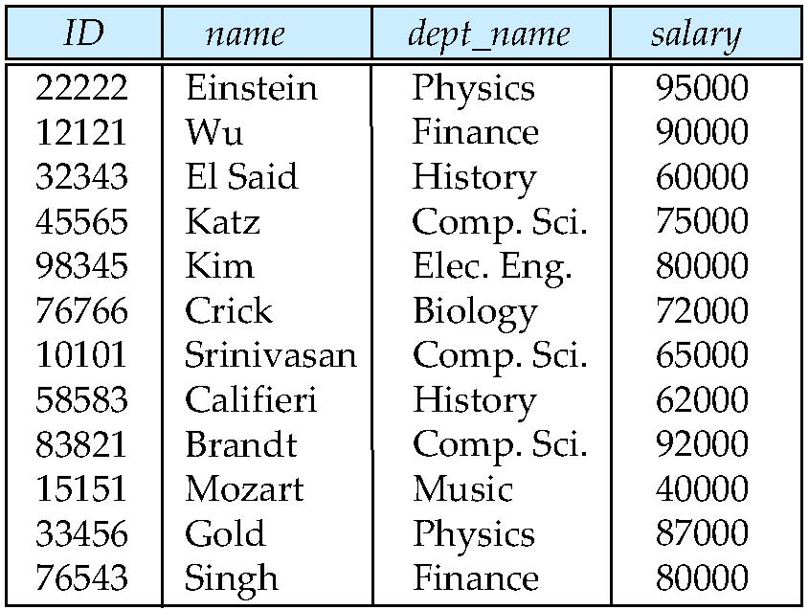
Relations are Unordered
Order of tuples is irrelevant (tuples may be stored in an arbitrary order)
Example: instructor relation with unordered tuples

Slide 12
Database
A database consists of multiple relations
Information about an enterprise is broken up into parts
instructor student advisor
univ
…

Slide 13
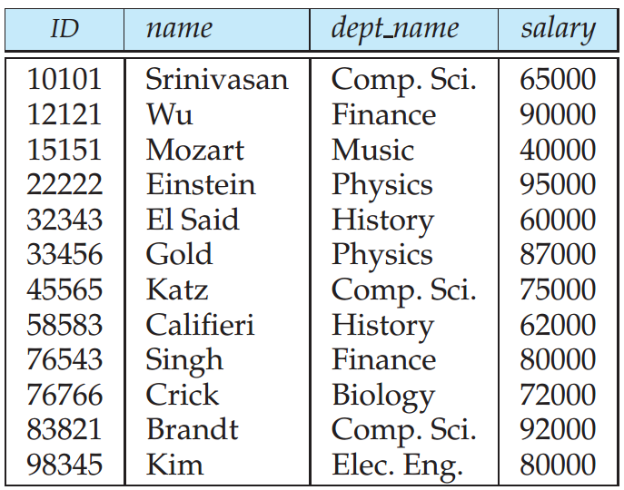
2.1.3 Keys 码、键、主键等
Let K ⊆ R = (A₁, A₂, …, A_{n}), set of attributes of relation r(R)
Superkey超码: K is a superkey of R if values for K are sufficient to identify a unique tuple of each possible relation r(R)
The ID attribute of the relation instructor is sufficient to distinguish one instructor tuple from another. Thus, ID is a superkey.
The name attribute of instructor, on the other hand, is not a superkey, because several instructors might have the same name.
Candidate key候选码: K is a candidate key if K is minimal e.g: Suppose that a combination of name and dept name
is sufficient to distinguish among
members of the instructor relation.
Then, both {ID} and {name, dept name}
are candidate keys.
instructor

Slide 14
2.1.3 Keys 码、键、主键等
Primary key（主码）: a candidate key chosen as the principal means of identifying tuples within a relation
Should choose an attribute whose value never, or very rarely, changes.
Foreign key外码：
A relation schema may have an attribute that corresponds to the primary key of another relation. The attribute is called a foreign key(外键).
referenced relation（被参照关系） & referencing relation（参照关系）.

Slide 15
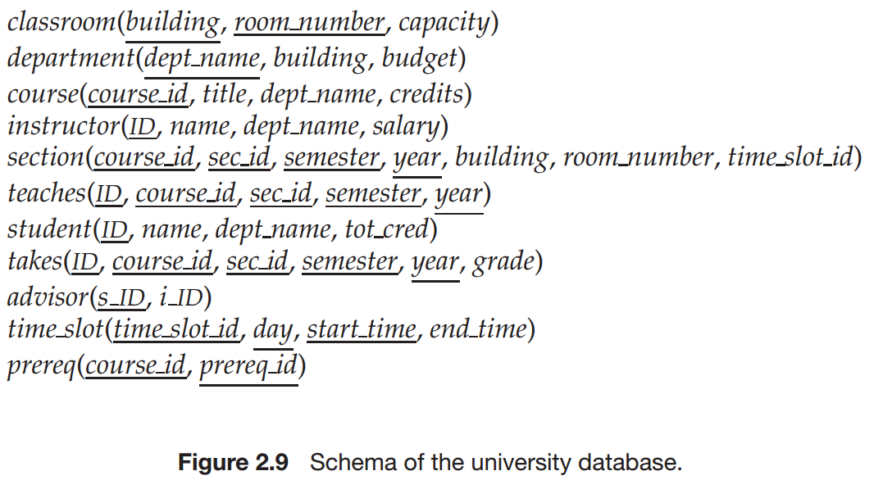
Schema of the university database

Slide 16
2.4 Schema Diagram for University Database

Slide 17
2.5 Query Languages
Query Language: user requests information from the database.
Categories of languages
Procedural 过程化
non-procedural 非过程化
SQL (ch. 3, ch. 4)
“Pure” languages 抽象的查询语言:
Relational Algebra关系代数 (Section 6.1)
Tuple Relational Calculus 元组关系演算(Section 6.2)
Domain Relational Calculus 域关系演算(Section 6.3)
Relational operators

Slide 18
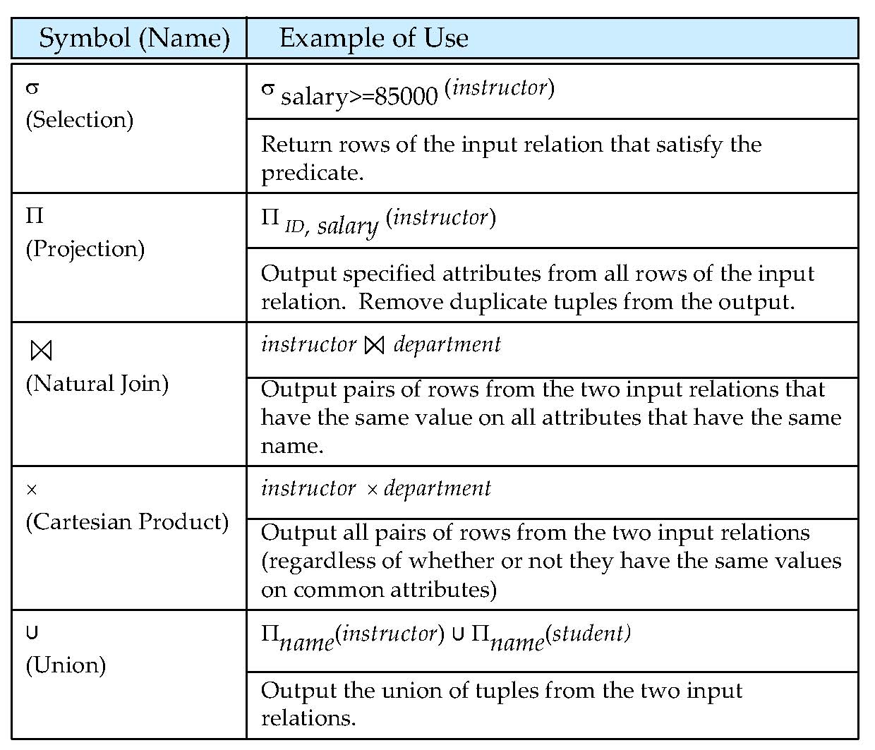
2.6 Relational operators

Slide 19
Relational Algebra
Six basic operators
select: σ
project: ∏
union: ∪
set difference: –
Cartesian product: x
rename: ρ
The operators take one or two relations as inputs and produce a new relation as a result.

Slide 20
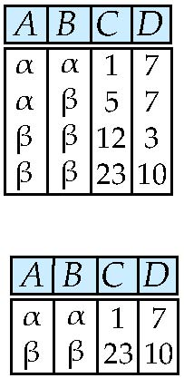
Selection of tuples
Relation r
Select tuples with A=B and D > 5
σ _{A=B and D > 5} (r)

Slide 21
Select Operation
Notation: σ _{p}(r)
p is called the selection predicate
Defined as: σ_{p}(r) = {t | t ∈ r and p(t)}
Where p is a formula in propositional calculus consisting of terms connected by : ∧ (and), ∨ (or), ¬ (not) Each term is one of:
<attribute>op <attribute> or <constant>
where op is one of: =, ≠, >, ≥. <. ≤
Example of selection: σ _{dept_name=“Physics”}(instructor)

Slide 22
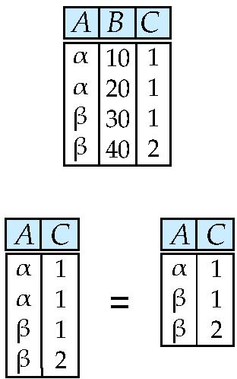
Project Operation – Example
Relation r:
Select A and C
Projection
Π _{A, C} (r)

Slide 23
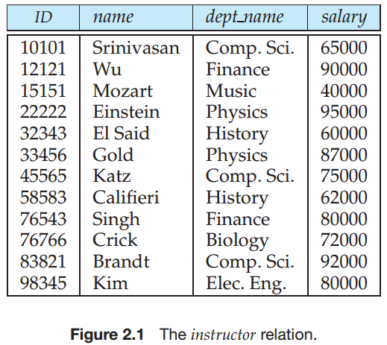
Project Operation
Notation:
where A₁, A₂ are attribute names and r is a relation name.
The result is defined as the relation of k columns obtained by erasing the columns that are not listed
Duplicate rows removed from result, since relations are sets
Example: To eliminate the dept_name attribute of instructor

Slide 24
Project Operation
Notation:
where A₁, A₂ are attribute names and r is a relation name.
The result is defined as the relation of k columns obtained by erasing the columns that are not listed
Duplicate rows removed from result, since relations are sets
Example: To eliminate the dept_name attribute of instructor ∏_{ID, name, salary} (instructor)

Slide 25
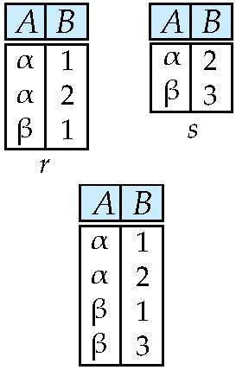
Union of two relations
Relations r, s:
r ∪ s:

Slide 26
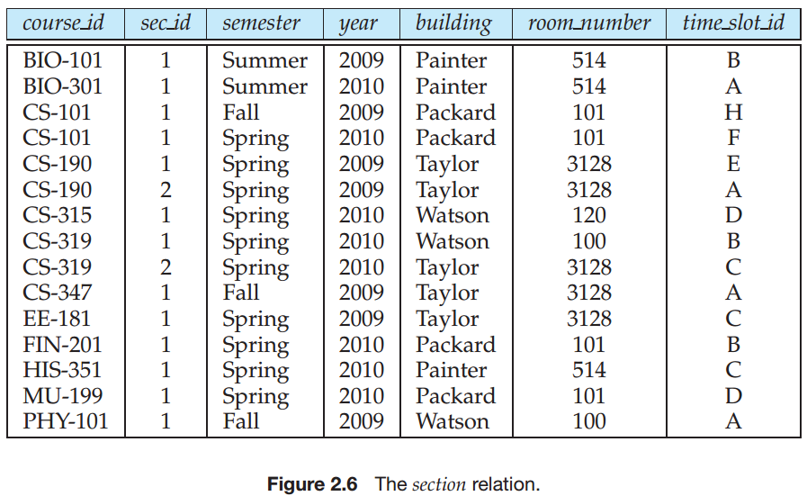
Union Operation
Notation: r ∪ s
Defined as:
r ∪ s = {t | t ∈ r or t ∈ s}
For r ∪ s to be valid.
1. r, s must have the same arity (same number of attributes)
2. The attribute domains must be compatible (example: 2nd column of r deals with the same type of values as does the 2nd column of s)
Example: to find all courses taught in the Fall 2009 semester, or in the Spring 2010 semester, or in both

Slide 27
Union Operation
Example: to find all courses taught in the Fall 2009 semester, or in the Spring 2010 semester, or in both ∏_{course_id} (σ _{semester=“Fall” Λ year=2009} (section)) ∪ ∏_{course_id} (σ _{semester=“Spring” Λ year=2010} (section))

Slide 28
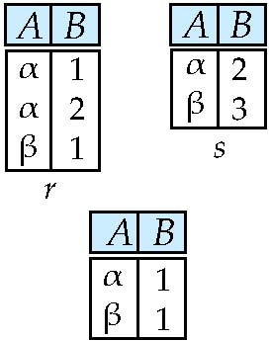
Set difference of two relations
Relations r, s:
r – s:

Slide 29
Set Difference Operation
Notation r – s
Defined as:
r – s = {t | t ∈ r and t ∉ s}
Set differences must be taken between compatible relations.
r and s must have the same arity
attribute domains of r and s must be compatible
Example: to find all courses taught in the Fall 2009 semester, but not in the Spring 2010 semester

Slide 30
Set Difference Operation
Example: to find all courses taught in the Fall 2009 semester, but not in the Spring 2010 semester ∏_{course_id} (σ _{semester=“Fall” Λ year=2009} (section)) − ∏_{course_id} (σ _{semester=“Spring” Λ year=2010} (section))

Slide 31
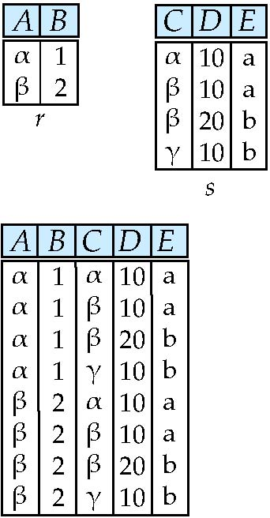
Cartesian-Product Operation – Example
Relations r, s:
r x s:

Slide 32
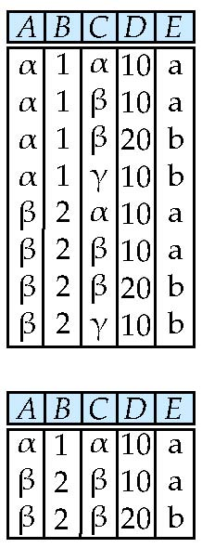
Composition of Operations
Can build expressions using multiple operations
Example: σ_{A=C}(r x s)
r x s
σ_{A=C}(r x s)

Slide 33
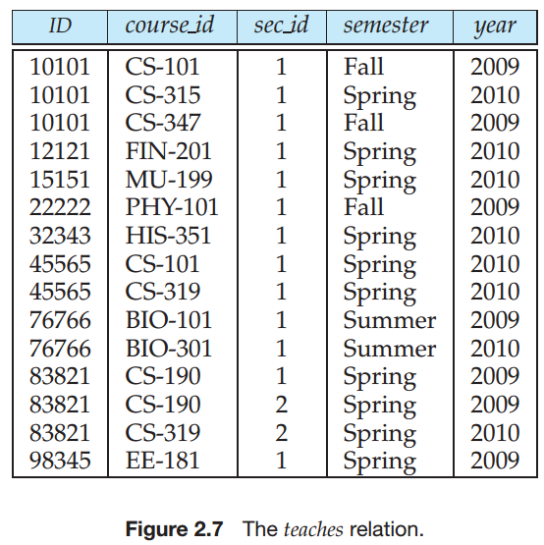
Cartesian-Product Operation
Notation r x s
Defined as:
r x s = {t q | t ∈ r and q ∈ s}
Assume that attributes of r(R) and s(S) are disjoint. (That is, R ∩ S = ∅).
If attributes of r(R) and s(S) are not disjoint, then renaming must be used.

Slide 34
Example
Suppose that we want to find the names of all instructors in the Physics department together with the course id of all courses they taught.

Slide 35
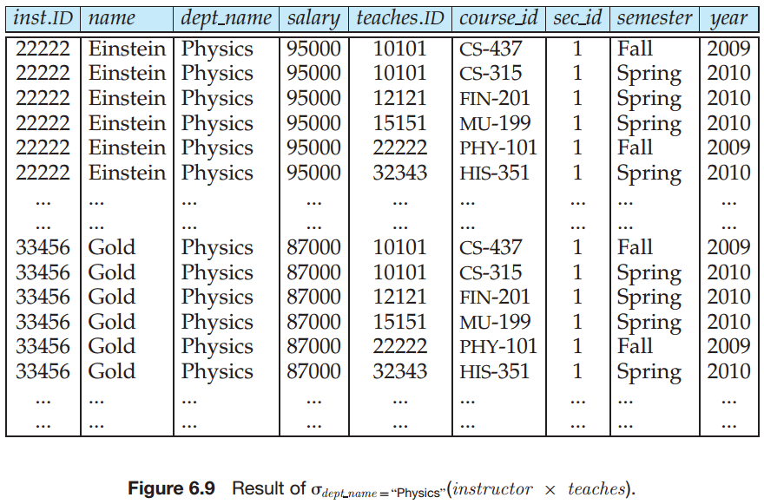

Slide 36
Example
Suppose that we want to find the names of all instructors in the Physics department together with the course id of all courses they taught.

Slide 37
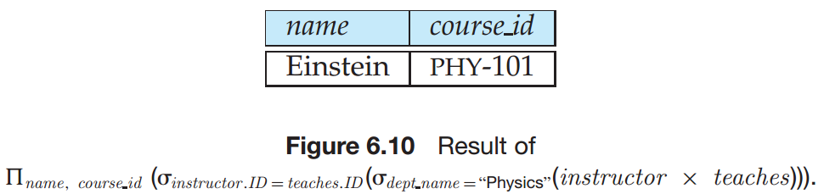
Example
Suppose that we want to find the names of all instructors in the Physics department together with the course id of all courses they taught.

Slide 38
Example
Note that there is often more than one way to write a query in relational algebra. Consider the following query:

Slide 39
Rename Operation
Allows us to name, and therefore to refer to, the results of relational-algebra expressions.
Allows us to refer to a relation by more than one name.
Example:
ρ _{x} (E)
returns the expression E under the name X
If a relational-algebra expression E has arity n, then
returns the result of expression E under the name X, and with the
attributes renamed to A₁ , A₂ , …., A_{n} .

Slide 40
Example Query
Find the largest salary in the university

Slide 41
Example Query
Find the largest salary in the university
Step 1: find instructor salaries that are less than some other instructor salary (i.e. not maximum)
using a copy of instructor under a new name d
∏_{instructor.salary} (σ _{instructor.salary < d.salary} (instructor x ρ_{d} (instructor)))

Slide 42
Example Query
Find the largest salary in the university
Step 1: find instructor salaries that are less than some other instructor salary (i.e. not maximum)
using a copy of instructor under a new name d
∏_{instructor.salary} (σ _{instructor.salary < d,salary} (instructor x ρ_{d} (instructor)))
Step 2: Find the largest salary
∏_{salary} (instructor) – ∏_{instructor.salary} (σ _{instructor.salary < d,salary} (instructor x ρ_{d} (instructor)))

Slide 43
6.1.3 Additional Relational-Algebra Operations
6.1.3.1 The Set-Intersection Operation
6.1.3.2 The Natural-Join Operation
6.1.3.3 The Assignment Operation
6.1.3.4 Outer join Operations

Slide 44
6.1.3.1 Set-Intersection Operation
Notation: r ∩ s
Defined as:
r ∩ s = { t | t ∈ r and t ∈ s }
Assume:
r, s have the same arity
attributes of r and s are compatible
Note: r ∩ s = r – (r – s)

Slide 45
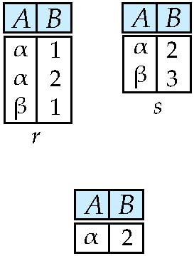
Set-Intersection Operation – Example
Relation r, s:
r ∩ s

Slide 46
6.1.3.2 Natural-Join Operation
Notation: r s
Let r and s be relations on schemas R and S respectively. Then, r s is a relation on schema R ∪ S obtained as follows:
Consider each pair of tuples t_{r} from r and t_{s} from s.
If t_{r} and t_{s} have the same value on each of the attributes in R ∩ S, add a tuple t to the result, where
t has the same value as t_{r} on r
t has the same value as t_{s} on s
Example:
R = (A, B, C, D)
S = (E, B, D)
Result schema = (A, B, C, D, E)
r s is defined as: ∏_{r.A, r.B, r.C, r.D, s.E} (σ_{r.B = s.B ∧ r.D = s.D} (r x s))

Slide 47
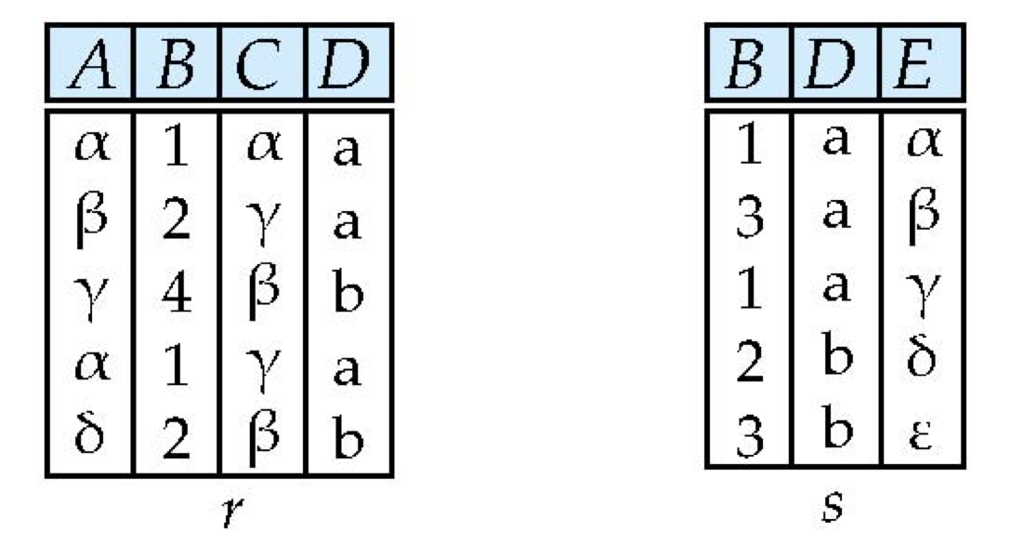
Natural Join Example
Relations r, s:
r s

Slide 48
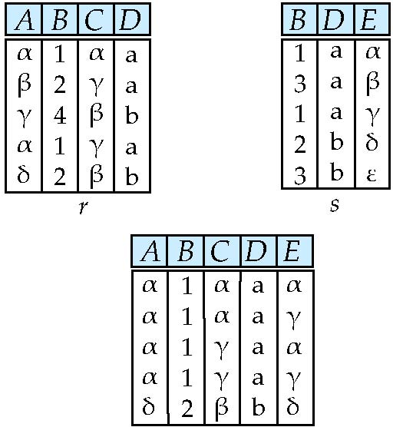
Natural Join Example
Relations r, s:
r s

Slide 49
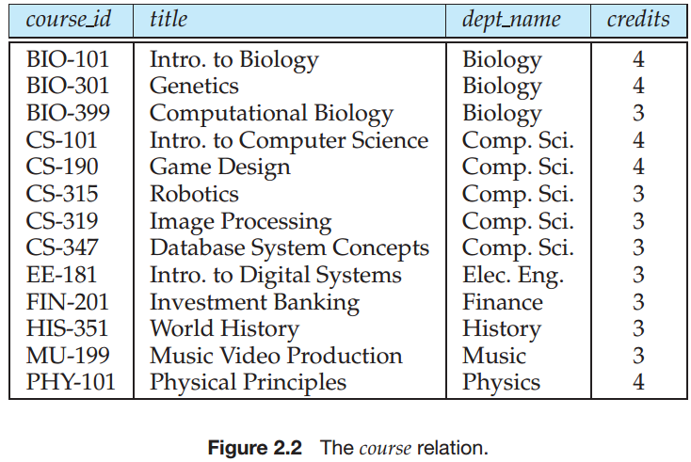
Natural Join and Theta Join
Find the names of all instructors in the Comp. Sci. department together with the course titles of all the courses that the instructors teach

Slide 50
Natural Join and Theta Join
Find the names of all instructors in the Comp. Sci. department together with the course titles of all the courses that the instructors teach
∏ _{name, title} (σ _{dept_name=“Comp. Sci.”} (instructor teaches course))
Natural join is associative
(instructor teaches) course is equivalent to instructor (teaches course)
Natural join is commutative
instruct teaches is equivalent to teaches instructor
The theta join operation r _{θ} s is defined as
r _{θ} s = σ_{θ} (r x s)

Slide 51
6.1.3.3 Assignment Operation
The assignment operation (←) provides a convenient way to express complex queries.
Write query as a sequential program consisting of
a series of assignments
followed by an expression whose value is displayed as a result of the query.
Assignment must always be made to a temporary relation variable.

Slide 52
6.1.3.4 Outer Join
An extension of the join operation that avoids loss of information.
Computes the join and then adds tuples form one relation that does not match tuples in the other relation to the result of the join.
Uses null values:
null signifies that the value is unknown or does not exist
All comparisons involving null are (roughly speaking) false by definition.
We shall study precise meaning of comparisons with nulls later

Slide 53
Outer Join – Example
Relation instructor1
ID
name
dept_name
10101
12121
15151
Srinivasan
Wu
Mozart
Comp. Sci.
Finance
Music
Relation teaches1
ID
course_id
10101
12121
76766
CS-101
FIN-201
BIO-101

Slide 54
Outer Join – Example
Join instructor teaches
Notes:
自然连接
左连接

Slide 55
Outer Join – Example
Join instructor teaches
ID
name
dept_name
course_id
10101
12121
Srinivasan
Wu
Comp. Sci.
Finance
CS-101
FIN-201
Left Outer Join
instructor teaches
ID
name
dept_name
course_id
10101
12121
15151
Srinivasan
Wu
Mozart
Comp. Sci.
Finance
Music
CS-101
FIN-201
null

Slide 56
Outer Join – Example
Right Outer Join
instructor teaches
ID
name
dept_name
course_id
10101
12121
76766
Srinivasan
Wu
null
Comp. Sci.
Finance
null
CS-101
FIN-201
BIO-101
Full Outer Join
instructor teaches
ID
name
dept_name
course_id
10101
12121
15151
76766
Srinivasan
Wu
Mozart
null
Comp. Sci.
Finance
Music
null
CS-101
FIN-201
null
BIO-101

Slide 57
Outer Join using Joins
Outer join can be expressed using basic operations
e.g. r s can be written as
(r s) U (r – ∏_{R}(r s) x {(null, …, null)}

Slide 58
6.1.4 Extended Relational-Algebra Operations
6.1.4.1 Generalized Projection
6.1.4.2 Aggregation

Slide 59
6.1.4.1 Generalized Projection
Extends the projection operation by allowing arithmetic functions to be used in the projection list.
E is any relational-algebra expression
Each of F₁, F₂, …, F_{n} are are arithmetic expressions involving constants and attributes in the schema of E.
Given relation instructor(ID, name, dept_name, salary) where salary is annual salary, get the same information but with monthly salary
∏_{ID, name, dept_name, salary/12} (instructor)

Slide 60

6.1.4.2 Aggregate Functions and Operations
Aggregation function takes a collection of values and returns a single value as a result.
avg: average value min: minimum value max: maximum value sum: sum of values count: number of values
Aggregate operation in relational algebra
E is any relational-algebra expression
G₁, G₂ …, G_{n} is a list of attributes on which to group (can be empty)
Each F_{i} is an aggregate function
Each A_{i} is an attribute name
Note: Some books/articles use γ instead of (Calligraphic G)

Slide 61
Aggregate Operation – Example
Relation r:
A
B
C
α
α
β
β
α
β
β
β
7
7
3
10
_{sum(c)} (r)
sum(c )
27

Slide 62
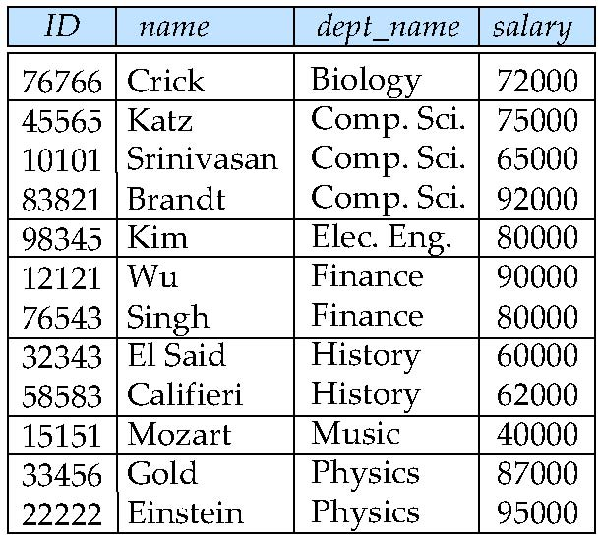
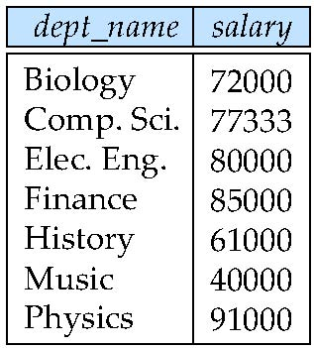
Aggregate Operation – Example
Find the average salary in each department
avg_salary

Slide 63
Aggregate Operation – Example
Find the average salary in each department
_{dept_name} _{avg(salary)} (instructor)
avg_salary

Slide 64
Aggregate Functions (Cont.)
Result of aggregation does not have a name
Can use rename operation to give it a name
For convenience, we permit renaming as part of aggregate operation
_{dept_name} _{avg(salary) as avg_sal} (instructor)

Slide 65
Modification of the Database
The content of the database may be modified using the following operations:
Deletion
Insertion
Updating
All these operations can be expressed using the assignment operator
删除操作的形式化定义为r←r−E，当中r是关系实例，E是关系代数查询表达式
插入操作的形式化定义为r←r∪E，当中r是关系实例，E是关系代数查询表达式或者常量元组集合

Slide 66
Deletion: Examples
Delete all account records in the Perryridge branch.
account ← account – σ _{branch-name = “Perryridge”} (account)
Delete all loan records with amount in the range of 0 to 50
loan ← loan – σ amount ≥ 0 and amount ≤ 50 (loan)

Slide 67
Insertion: Examples
Insert information in the database specifying that Smith has $1200 in account A-973 at the Perryridge branch.
account ← account ∪ {(“Perryridge”, A-973, 1200)}
depositor ← depositor ∪ {(“Smith”, A-973)}

Slide 68
Multiset Relational Algebra
Pure relational algebra removes all duplicates
e.g. after projection
Multiset relational algebra retains duplicates, to match SQL semantics
SQL duplicate retention was initially for efficiency, but is now a feature
Multiset relational algebra defined as follows
selection: has as many duplicates of a tuple as in the input, if the tuple satisfies the selection
projection: one tuple per input tuple, even if it is a duplicate
cross product: If there are m copies of t1 in r, and n copies of t2 in s, there are m x n copies of t1.t2 in r x s
Other operators similarly defined
E.g. union: m + n copies, intersection: min(m, n) copies difference: min(0, m – n) copies

Slide 69
SQL and Relational Algebra
select A1, A2, .. An from r1, r2, …, rm where P
is equivalent to the following expression in multiset relational algebra
∏ _{A1, .., An} (σ _{P} (r1 x r2 x .. x rm))
select A1, A2, sum(A3) from r1, r2, …, rm where P group by A1, A2
is equivalent to the following expression in multiset relational algebra
_{A1, A2} _{sum(A3)} (σ _{P} (r1 x r2 x .. x rm)))

Slide 70
SQL and Relational Algebra
More generally, the non-aggregated attributes in the select clause may be a subset of the group by attributes, in which case the equivalence is as follows: select A1, sum(A3) from r1, r2, …, rm where P group by A1, A2
is equivalent to the following expression in multiset relational algebra
∏ _{A1,sumA3}( _{A1,A2} _{sum(A3)} _{as sumA3}(σ _{P} (r1 x r2 x .. x rm)))

Slide 71
Null Values
It is possible for tuples to have a null value, denoted by null, for some of their attributes
null signifies an unknown value or that a value does not exist.
The result of any arithmetic expression involving null is null.
Aggregate functions simply ignore null values (as in SQL)
For duplicate elimination and grouping, null is treated like any other value, and two nulls are assumed to be the same (as in SQL)

Slide 72
Null Values
Comparisons with null values return the special truth value: unknown
If false was used instead of unknown, then not (A < 5) would not be equivalent to A >= 5
Three-valued logic using the truth value unknown:
OR: (unknown or true) = true, (unknown or false) = unknown (unknown or unknown) = unknown
AND: (true and unknown) = unknown, (false and unknown) = false, (unknown and unknown) = unknown
NOT: (not unknown) = unknown
In SQL “P is unknown” evaluates to true if predicate P evaluates to unknown
Result of select predicate is treated as false if it evaluates to unknown

Slide 73
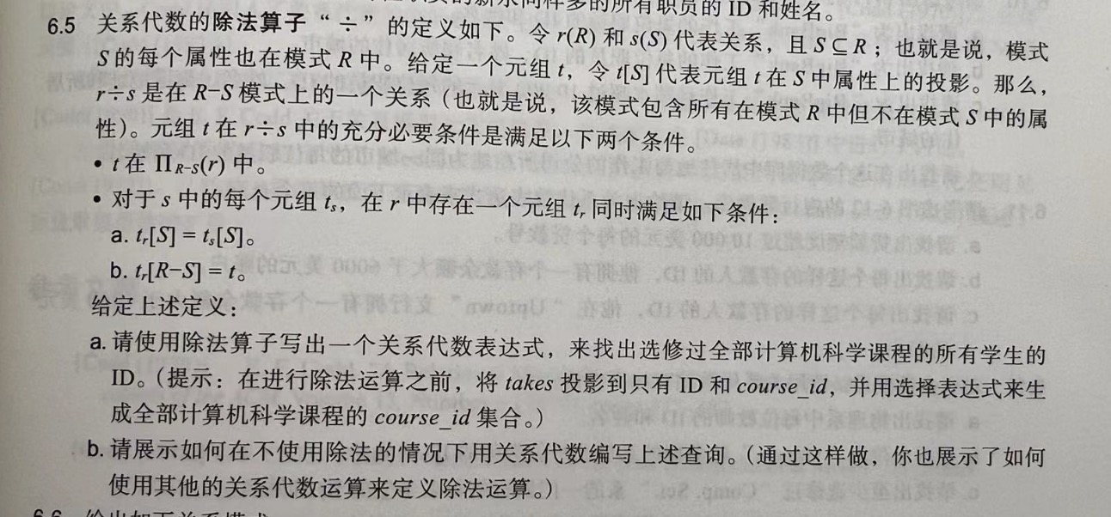
Division Operator

Slide 74
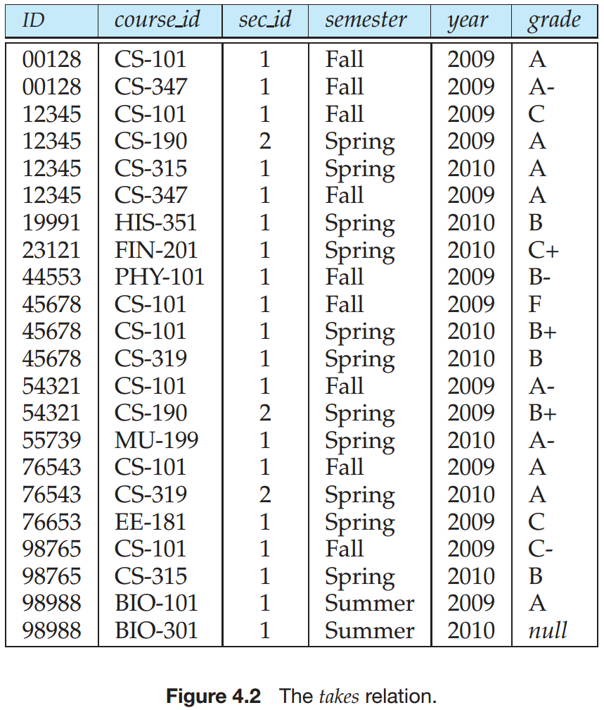
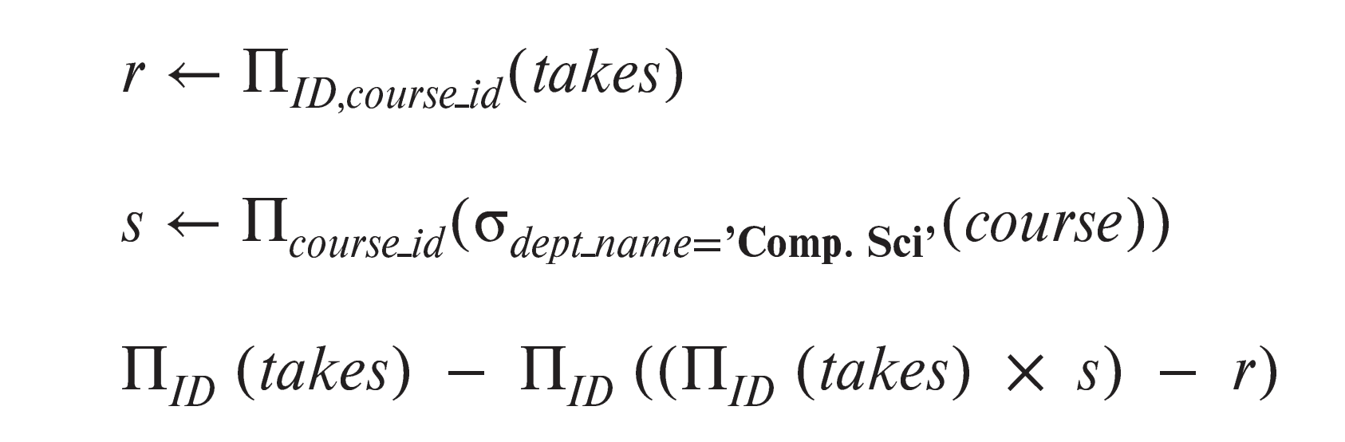

Slide 75
End of Chapter 2

Slide 76
Division Operator
Given relations r(R) and s(S), such that S ⊂ R, r ÷ s is the largest relation t(R-S) such that t x s ⊆ r
E.g. let r(ID, course_id) = ∏_{ID, course_id} (takes ) and s(course_id) = ∏_{course_id} (σ_{dept_name=“Comp.Sci.”}(course ) then r ÷ s gives us students who have taken all courses in the Computer Science department
Can write r ÷ s as
temp1 ← ∏_{R-S} (r ) temp2 ← ∏_{R-S} ((temp1 x s ) – ∏_{R-S,S} (r )) result = temp1 – temp2
The result to the right of the ← is assigned to the relation variable on the left of the ←.
May use variable in subsequent expressions.

Slide 77
